Slide 1

Product Analytics:
DONE BY ASEEM KAIPAKASSERI

Slide 2
PROJECT OBJECTIVE :
Objective: Analyse Amazon India's catalogue to evaluate pricing, discounts, customer sentiment, and category performance.
Value Delivered:
Data-Driven Insights: Identifies categories with the best value, highest satisfaction, and strongest engagement.
Strategic Empowerment: Helps stakeholders optimize pricing strategies and focus inventory effectively through an interactive dashboard.

Slide 3
DATASET OVERVIEW — 16 ORIGINAL COLUMNS
Product & Catalog:
Product_id
Product_name
Category
About_product
Image_link
Product_link
Pricing & Discount
Discounted_price
Actual_price
Discount_percentage
Ratings & Reviews
Rating
Rating_count
Review_id
Review_title
Review_content
User Identity
User_id
User_name

Slide 4
EXCEL PRE-PROCESSING TASKS
Remove Duplicates
Handle missing values
Standardize price & percentage formats
Split category into hierarchy columns
Create Pivot Tables for validation
Build pivot table

Slide 5
ADDED CALCULATED COLUMNS
Savings_amount Discount_tier
Rating_band
Price_segment
Popularity_score
Value_score
Review_count

Slide 6
DAX MEASURES FOR POWER BI
Avg Rating=AVERAGE
Total Products=DISTINCTCOUNT
Avg Discount %=AVERAGE
Total Reviews=SUM
Avg Savings (₹)=AVERAGE
High Discount Products=CALCULATE(COUNTROWS(amazon), amazon[discount_percentage] >= 70)
Top Rated Products=CALCULATE(COUNTROWS(amazon), amazon[rating] >= 4.5)
Avg Popularity Score=AVERAGE
Max Savings Product=MAXX

Slide 7
DAX MEASURES FOR POWER BI
Avg Rating=AVERAGE
Total Products=DISTINCTCOUNT
Avg Discount %=AVERAGE
Total Reviews=SUM
Avg Savings (₹)=AVERAGE
High Discount Products=CALCULATE(COUNTROWS(amazon), amazon[discount_percentage] >= 70)
Top Rated Products=CALCULATE(COUNTROWS(amazon), amazon[rating] >= 4.5)
Avg Popularity Score=AVERAGE
Max Savings Product=MAXX

Slide 8
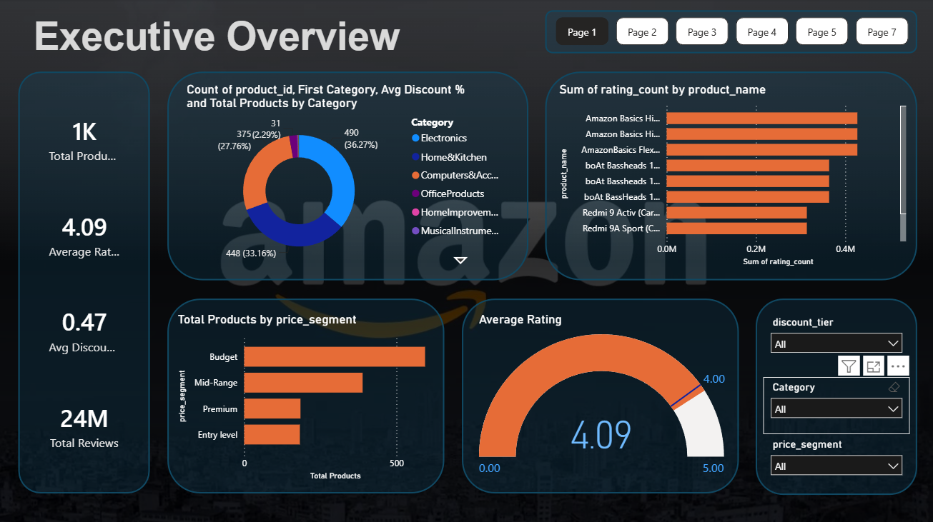
Page 1- Executive Overview
Cards display a single aggregated value each. Place in a 4-column row at the top of the page. These respond to all slicers.
The donut shows market concentration clearly.
Stacked bar chart shows which products have the widest customer engagement regardless of rating score.
Clustered Bar chart shows whether Amazon India's catalogue skews toward affordable or premium products.
Guage gives us a quick visual health check.

Slide 9
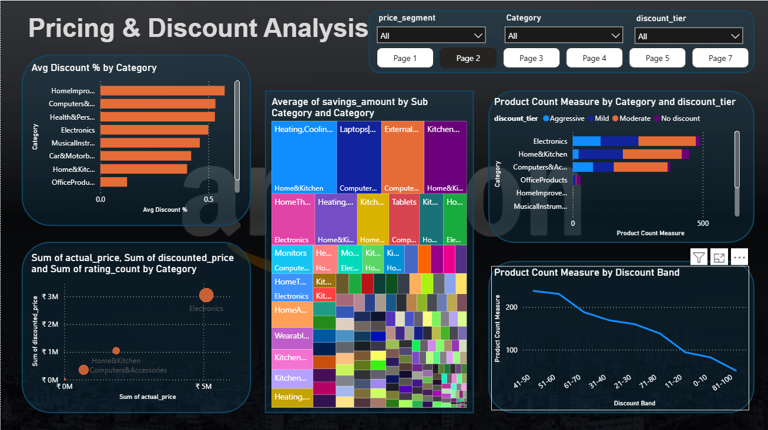
Page 2- Pricing & Discount Analysis
Stacked bar chart shows which category applies the deepest discounts on average. It is important for pricing strategy review.
Scatter Chart reveals pricing gap per category visually.
Tree map Instantly shows where rupee savings concentrate.
Stacked bar chart shows whether one category over-relies on aggressive discounting vs another. The stack composition reveals discount strategy differences across categories.
Line chart shows the discount distribution shape, whether products cluster around 40–60% or spread evenly. Reveals Amazon's dominant pricing pattern.

Slide 10
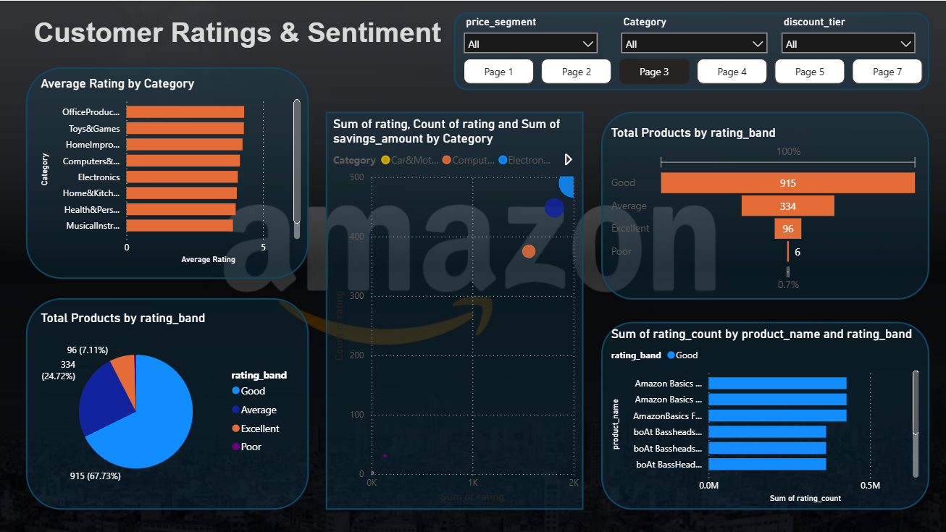
Page 3- Customer Ratings & Sentiment
Stacked bar chart: Which category earns the highest average customer satisfaction — useful for brand/product quality benchmarking.
Pie Chart: What proportion of the catalog is "Good or better"? Shows overall catalog quality distribution at a glance.
Scatter chart: Reveals hidden gems vs mainstream hits.
Clustered bar chart: Answers "are popular products good?"
Funnel Chart: Visually shows the quality pyramid — how many products make it to "Excellent" vs staying in "Good". Different from the donut (C12) which is part-to-whole; funnel shows a quality journey/drop-off.

Slide 11
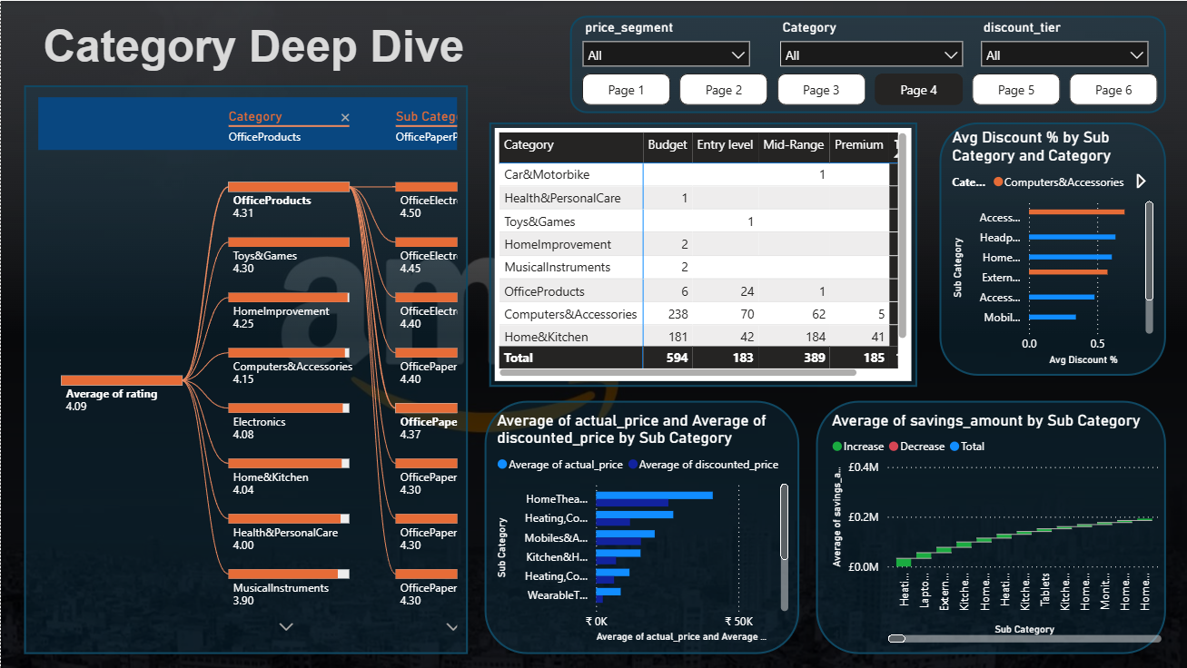
Page 4- Category Deep Dive
Decomposition tree: Drill from broad category all the way to a specific product to find where ratings peak or drop.
Clustered bar chart: Directly visualizes savings opportunity by sub-category.
Waterfall chart: Shows "where the savings money goes.“
Matrix: Which category-price-tier combinations are densely populated vs sparse. E.g., are there many Premium Electronics but few Premium Home&Kitchen products?
Clustered bar chart: Goes beyond simple ratings, sub-categories with both high ratings AND high review volumes rise to the top. A more reliable ranking than rating alone.

Slide 12
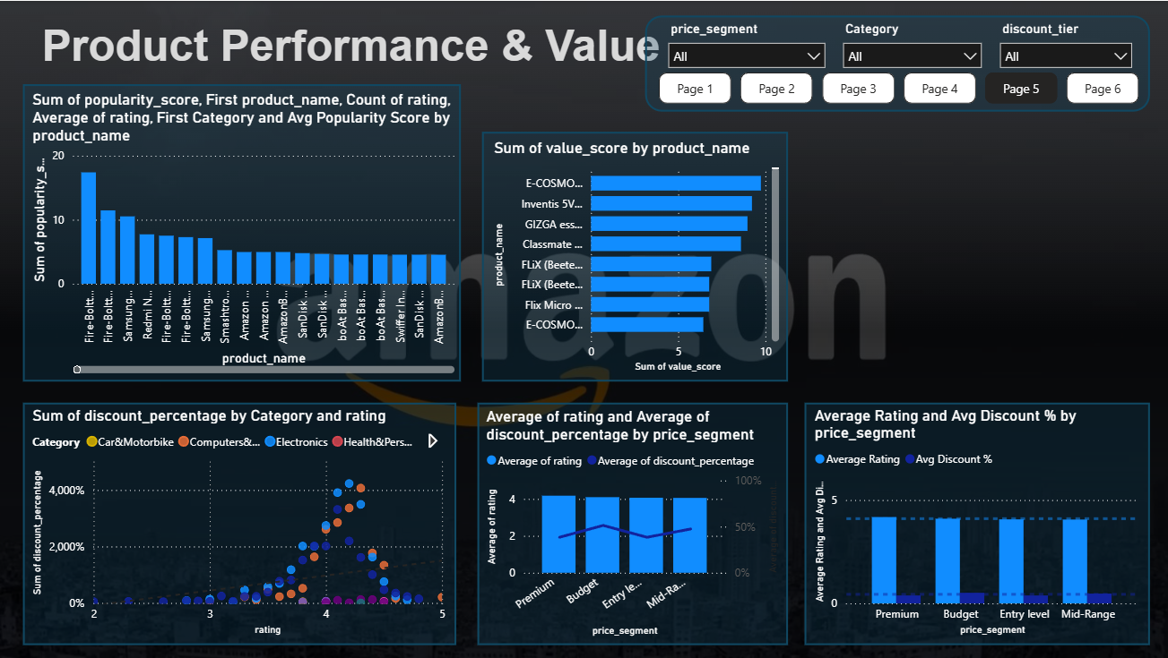
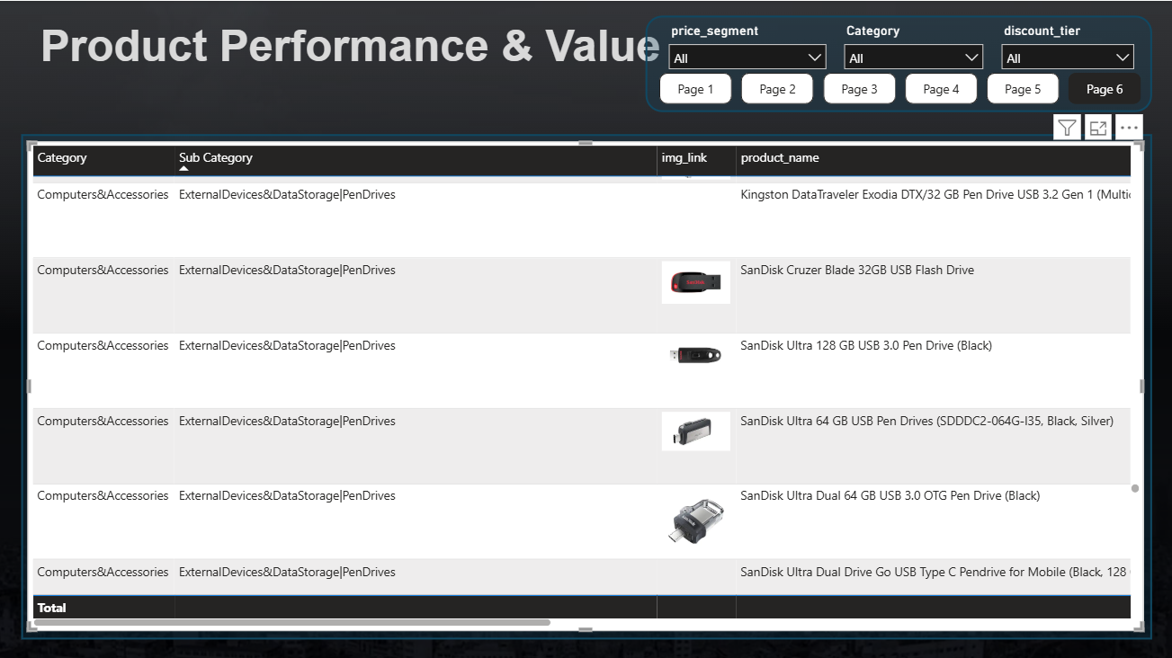
Page 5,6- Product Performance & Value
Stacked column chart: The true "best products" , not just highest rated OR most reviewed, but the best combination of both.
Scatter chart: The key analytical question , if trend line slopes downward, aggressive discounts correlate with poorer products. Flat/upward = discounts are independent of quality.
Stacked bar chart: Finds "hidden gem" products. Highly rated but very affordable.
Line and Clustered Column chart:Do Premium products get discounted less but rated higher? Or do Entry-Level products carry both deeper discounts AND lower ratings? A dual-axis answer to a classic pricing question.
Table: The most actionable view for product managers.

Slide 13
Conclusion
This analysis of 1,351 unique Amazon India products across 9 main categories reveals that Electronics and Computers & Accessories dominate the catalog with the widest price variation (₹39 to ₹77,990).
Discount strategies are aggressive — averaging above 40% — yet higher discounts do not consistently yield lower customer ratings, suggesting discounts are used as a legitimate marketing tool rather than a quality trade-off.
The popularity_score analysis surfaces that mid-range Accessories and Home & Kitchen products often outperform premium Electronics in customer engagement relative to price. The highest absolute savings are concentrated in Home Theater and Large Appliances, while the best value-for-money (rating per ₹100) belongs to affordable Cables, Accessories, and Office Products.
Recommendations: focus inventory expansion in mid-range electronics with 4.0+ ratings, investigate the 59 aggressively discounted products for pricing sustainability, and monitor the 47 products with 100,000+ reviews as flagship indicators of market demand.

